Slide 1
Data Extraction for the Quantified Self
Svetlana Pospelova
Viacheslav Inozemtsev

Slide 2
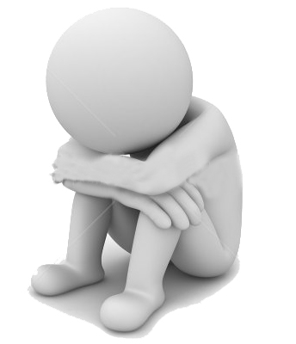
Introduction
Measurement of human’s indoor movements is useful for analyzing treatment progress of depressed people. It shows how actively person behaves, and gives objective view of his or her psychological condition. Our solution allows to do such measurements.

Slide 3
Approach
We analyze surrounding Wi-Fi networks to retrieve person’s indoor position. Signal strength of each network carries partial information about where he or she is at the moment. Combining this information we conclude person’s position.

Slide 4
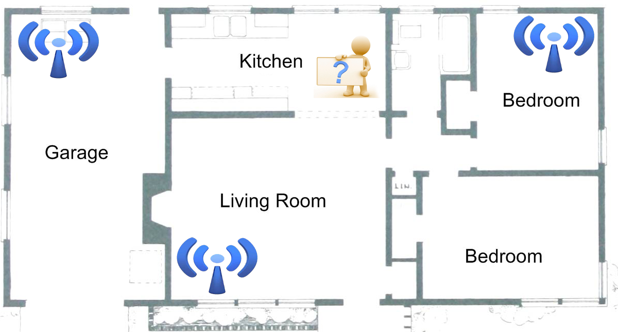
Approach

Slide 5
Implementation
We developed Android application, allowing to classify where the person is situated. We used machine learning techniques to obtain person’s position from surrounding Wi-Fi network signal strength. We chose k nearest neighbors algorithm for classification.

Slide 6
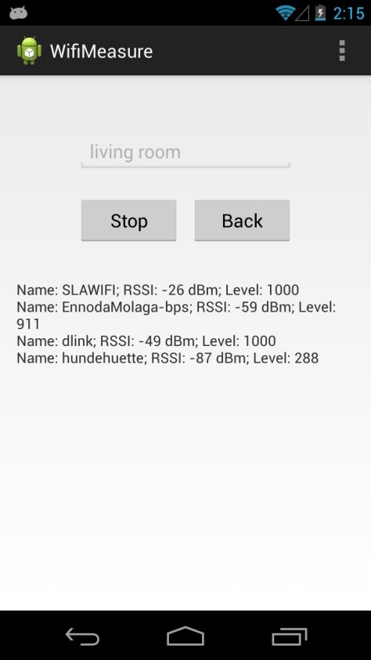

Slide 7
Prospects
Exhaustive testing for robustness
Analysis and possible substitution of classification algorithm
Implementation of the connectivity with the server

Slide 8
Thank you for your attention

